Slide 1
CS252a Project Proposal
Anjo Pagdanganan

Slide 2
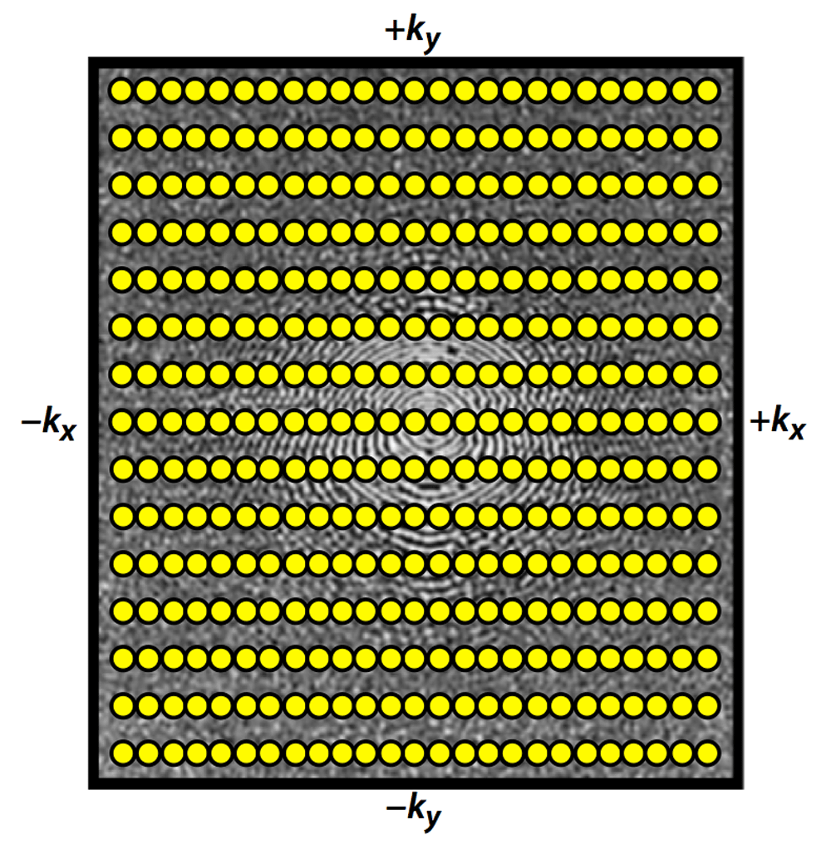
Background
MRI: Shoot radio waves at your subject, they emit radio waves back depending on how they are magnetized and the properties of their tissues
Samples you get back are the Fourier transform of their body
https://www.mriquestions.com/radial-sampling.html

Slide 3
Background
Conventional sampling techniques:
collect everything on a Cartesian grid → inverse FFT → image!
Takes a while! 5 minutes for a high quality, fully sampled 3D scan
Kind of rough for things like radiology where you want real-time MR views
https://www.mriquestions.com/radial-sampling.html

Slide 4
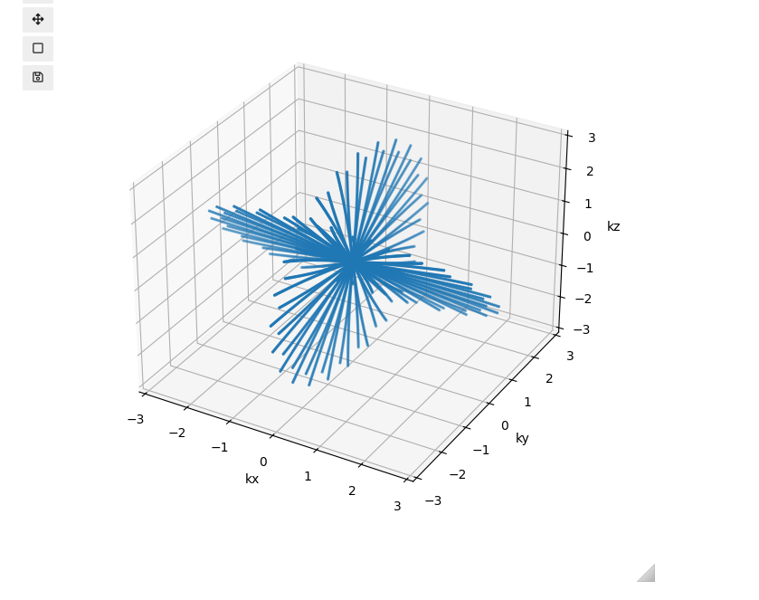
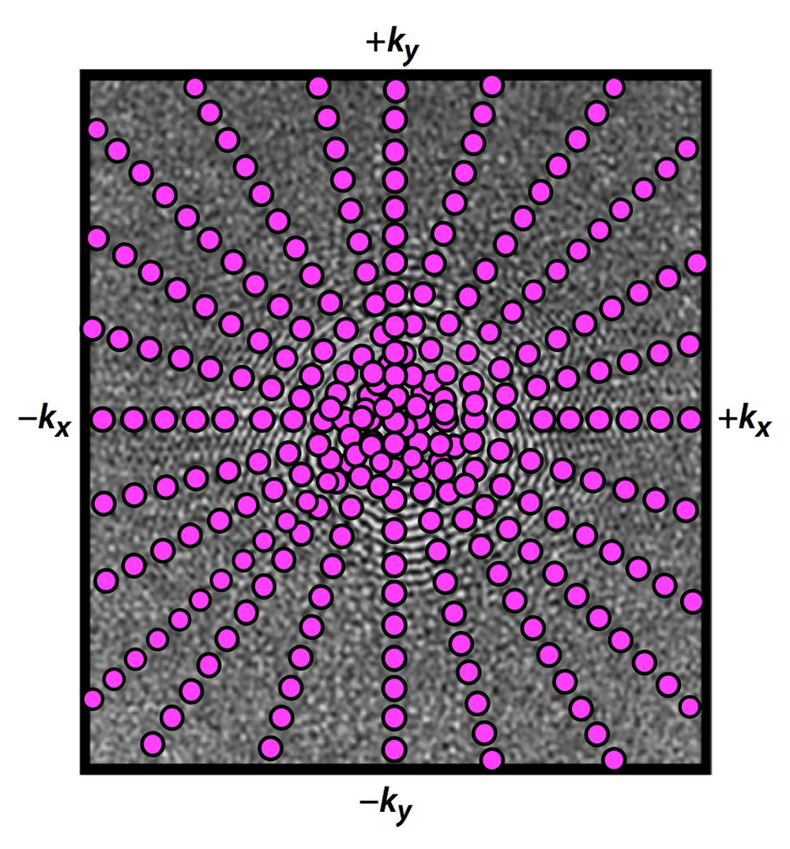
Background
Undersampling helps speed up the process
Radial undersampling is specifically robust to motion + tenable to some schemes that make things quieter
→ no longer on a Cartesian grid, can’t just inverse FFT
Many reconstruction methods use the
adjoint Non-Uniform Fast Fourier Transform
(NUFFT)
https://www.mriquestions.com/radial-sampling.html

Slide 5
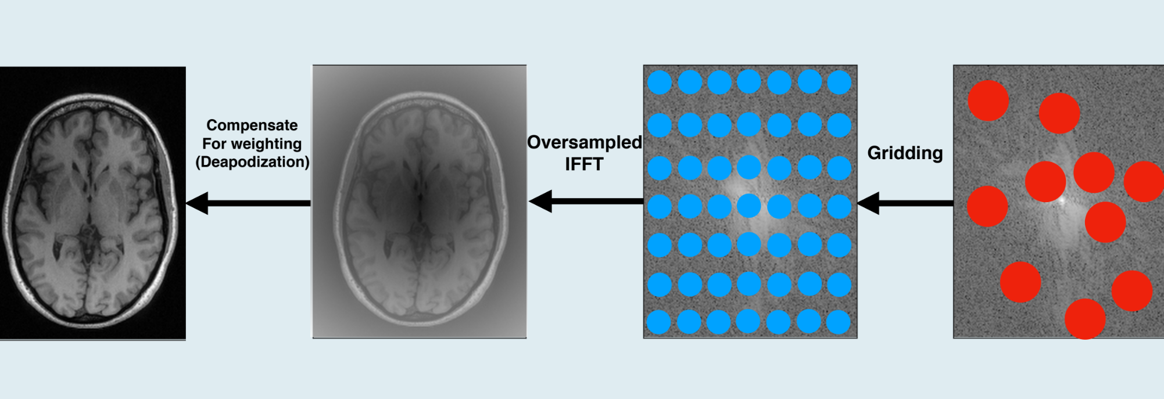
Adjoint NUFFT
(from Frank Ong’s Non-Cartesian Recon Tutorial)

Slide 6


Accelerating Adjoint NUFFT
Gridding operator: usually interpolation with Kaiser-Bessel kernel onto oversampled Cartesian grid
Explicit interpolation is time consuming
Instead, can summarize all interpolations into a big matrix multiplication
Resulting matrix is sparse

Slide 7
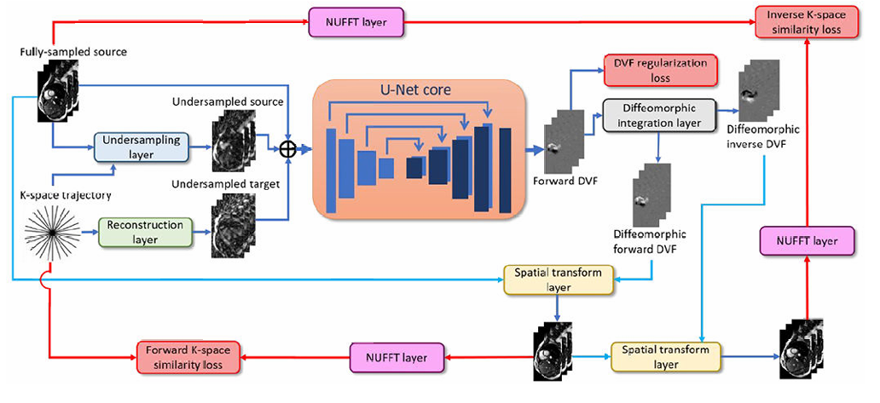
Shao et al

Slide 8
Experiments
Irregular memory access patterns… raises some questions
Memory bandwidth? Cache hit rate?
However, observe readout trajectory is structured and static

Slide 9
Goal + Experiments
Profile memory bandwidth, cache hit rate, wall clock speedup of representative 3D adjoint NUFFT reconstruction with Nvidia Nsight Compute
First step: profile which sparse matrix implementation optimizes these best
Current standard: naive COO implementation in torchkbnufft
If time permits, can we exploit properties of trajectory for better cache locality / parallelism?
…a custom kernel, or some sort of trajectory-aware software prefetching?

